Slide 1
NIDHI BARTAKKE
CSE
ROLLNO:1215316739

Slide 2
CONTENTS
Introduction
01
02
Levels of understanding Text
NLP Tools and Libraries
03
04
Deep Learning and NLP
Applications of NLP
05
06
Future of NLP
Notes:
© Copyright Showeet.com

Slide 3
NATURAL LANGUAGE PROCESSING
Natural Language Processing (NLP) is a sub-field of Artificial Intelligence that is focused on enabling computers to understand and process human languages, to get computers closer to a human-level understanding of language.

Slide 4
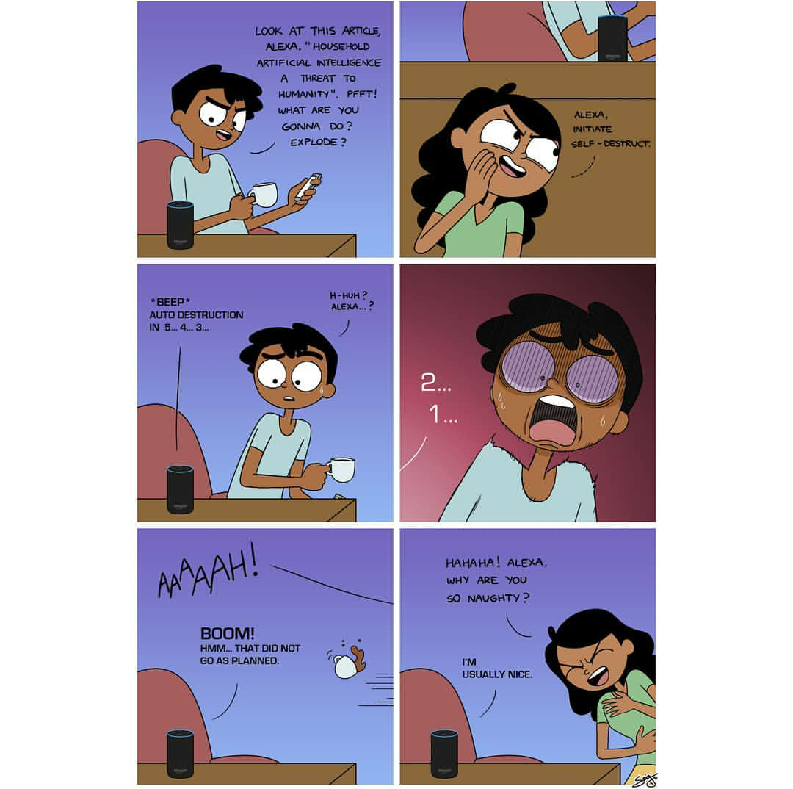
iNTRODUCTION

Slide 5
INTRODUCTION
Stmt1:“Steph Curry was on fire last night. He totally destroyed the other team”
Stmt 2:“The Pope’s baby steps on gays”

Slide 6
PARTS OF NLP
Natural Language Generation — The generation of natural language by a computer.
Natural Language Interaction---users communicate and evoke responses from systems via natural language.
Natural Language Understanding — The computers ability to understand what we say.

Slide 7
Language Processing
Level 1 – Speech sound (Phonetics & Phonology)
Level 2 – Words & their forms (Morphology, Lexicon)
Level 3 – Structure of sentences (Syntax, Parsing)
Level 4 – Meaning of sentences (Semantics)
Level 5 – Meaning in context & for a purpose (Pragmatics)
Level 6 – Connected sentence processing in a larger body of text (Discourse)

Slide 8
understanding Text
Parsing and Grammar
How is a sentence composed?
Lexicons
How is a word composed?
Ambiguity

Slide 9
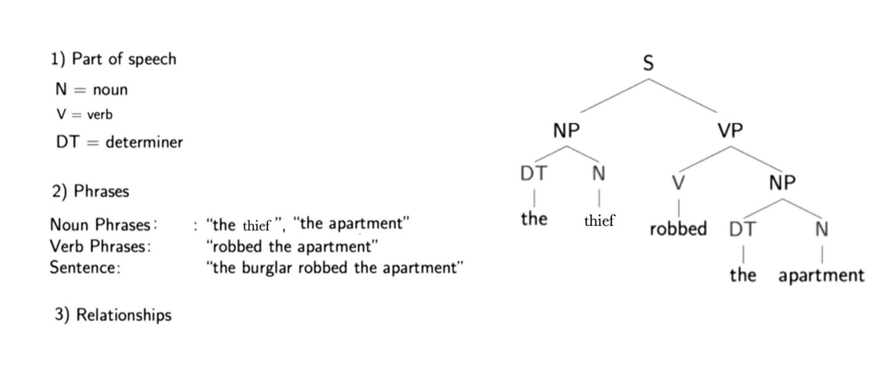
Parsing:
What is Parsing?
to parse: "resolve a sentence into its component parts and describe their syntactic roles.”
Template for a subject-verb relationship

Slide 10
2.STEMMING
# I was riding in the car.
Now, imagine all the English words in the vocabulary with all their different fixations at the end of them.
To store them all would require a huge database that would contain many words that actually mean the same.
# I was taking a ride in the car

Slide 11
3. Ambiguity
More extensive Language → more Ambiguity
Disambiguation:
task of finding correct interpretation
Evidence:
Syntactic
Lexical
Semantic
Metonymy
Metaphor

Slide 12
Semantic Disambiguation Example: “with”
SENTENCE
I ate spaghetti with meatballs. (ingredient of spaghetti)
I ate spaghetti with salad. (side dish of spaghetti)
I ate spaghetti with abandon. (manner of eating)
I ate spaghetti with a fork. (instrument of eating)
I ate spaghetti with a friend. (accompanier of eating)
Disambiguation is probabilistic!

Slide 13

Tools and libraries to solve NLP problems
NLTK (Natural Language Toolkit)
used for such tasks as tokenization, lemmatization, stemming, parsing, POS tagging, etc.
it is the best solution as it has tools for all NLP tasks

Slide 14



The best way NLTK should be used
interface for NLTK that turns text processing into a simple and quite enjoyable process,
rich functionality and good learning curve
detailed & understandable documentation
It can be used for rapid prototyping of various NLP models and can easily grow into full-scale projects.
TEXTBLOB:
Scikit-learn provides a large library for machine learning. The tools for text preprocessing are also presented here.
SPACY is main competitor to NLTK.
a recent addition to the field
only one & best solution for the task removing the problem of choosing the optimal route yourself, and ensuring the models built are lean, mean and efficient.

Slide 15
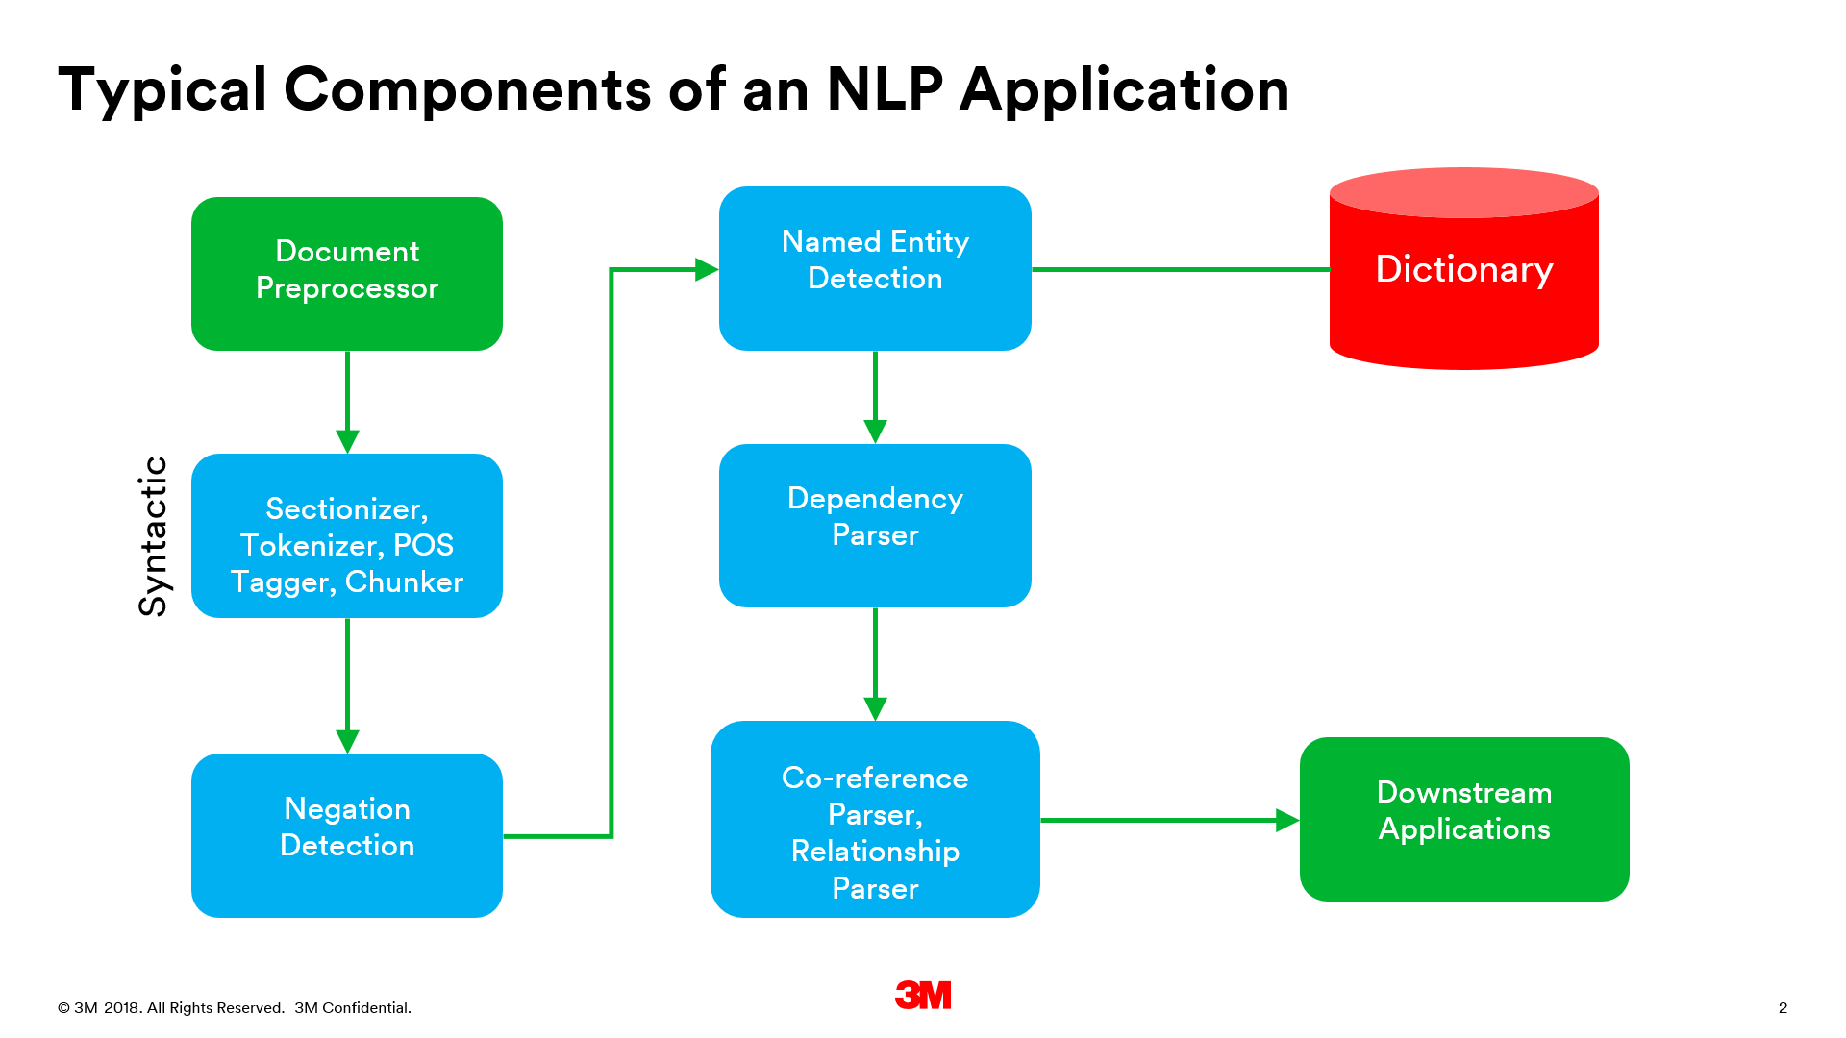
COMPONENTS IN NLP!!

Slide 16

DEEP LEARNING AND NLP
Multiple benefits:
Deep learning learns multiple levels of representation--the learned information is constructed level-by-level through composition. The lower level of representation often can be shared across tasks.
Human sentences are composed of words and phrases with a certain structure. Deep learning, is able to capture the sequence information in a much better sense.
a word is represented as a dense vector. A word embedding can be thought as a mapping function from the word to an n-dimensional space; that is,

Slide 17
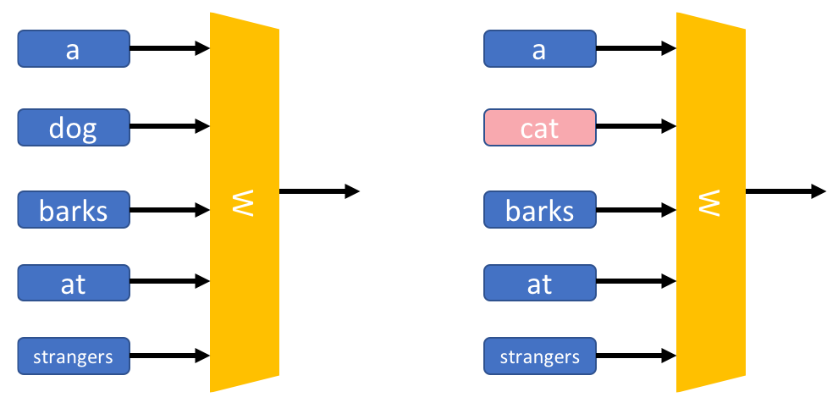
Example:
we train the model by feeding the n-gram through the lookup matrix W and get a vector that represents each word. The vectors are then combined through the output neuron, and we compare its results with the target value.

Slide 18
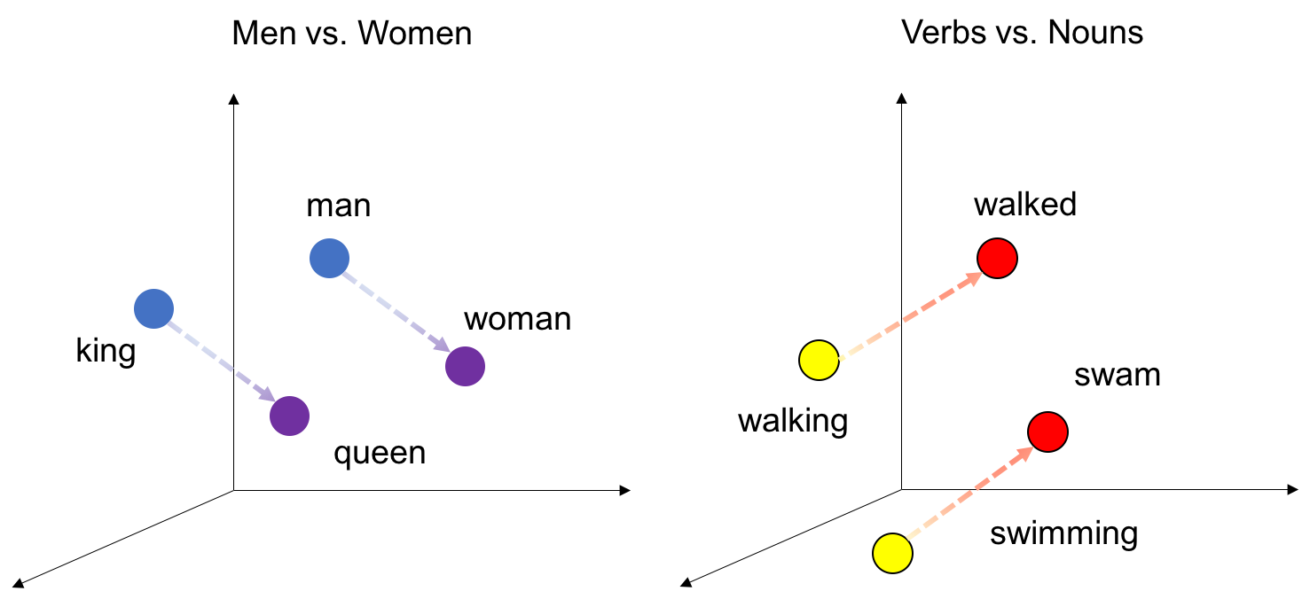
Interesting Results:
The location of the word representations in the high-dimensional space is determined by their meanings, such that words with close meanings are clustered together
word vectors have linear relationships-- The relationship between words can be thought as the direction and the distance formed by a pair of words. For example, starting from the location of the word king, move the same distance and direction between man and woman, and one will get the word queen.

Slide 19
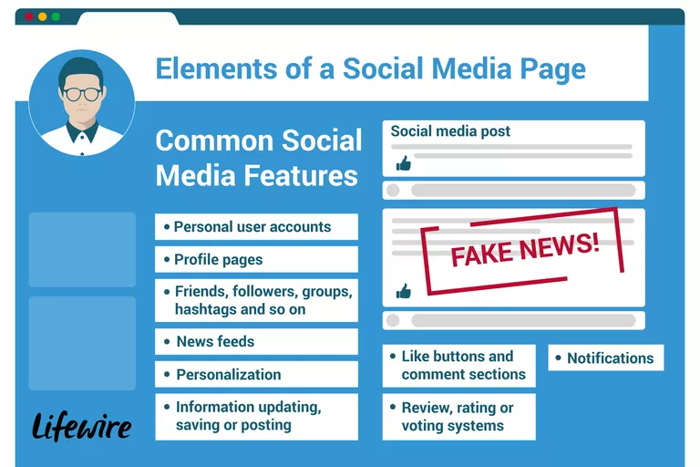
APPLICATIONS OF NLP !!
Machine Translation
Fighting Spam
Information Extraction
Summarization

Slide 20
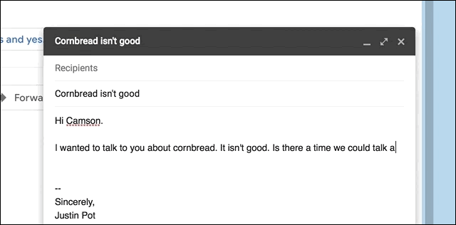
GMAIL’S Smart Compose
.

Slide 21
Google’s AI team faced three key challenges.
Latency: A critical challenge. The model should be able to predict the next words instantly for the user to not notice any delay or lag
Scale: Gmail is used by billions of users so the model should be able to customise it’s suggestions in different contexts
Fairness and Privacy: bias cannot be allowed otherwise the chances of failing and getting into a controversy are massive

Slide 22
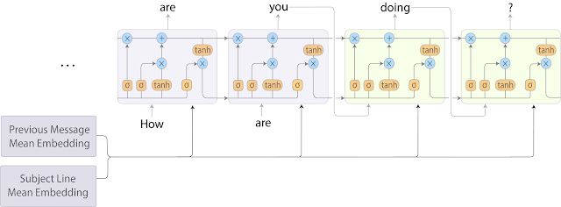
So they combined two models – the bag of words and the RNN-LM, which was a significant improvement on the sequence-to-sequence model in terms of speed.
RNN-LM:
Neural network based language models :statistical language modelling including automatic
speech recognition and machine translation, and provide significant improvements over classic
backoff n-gram models.

Slide 23
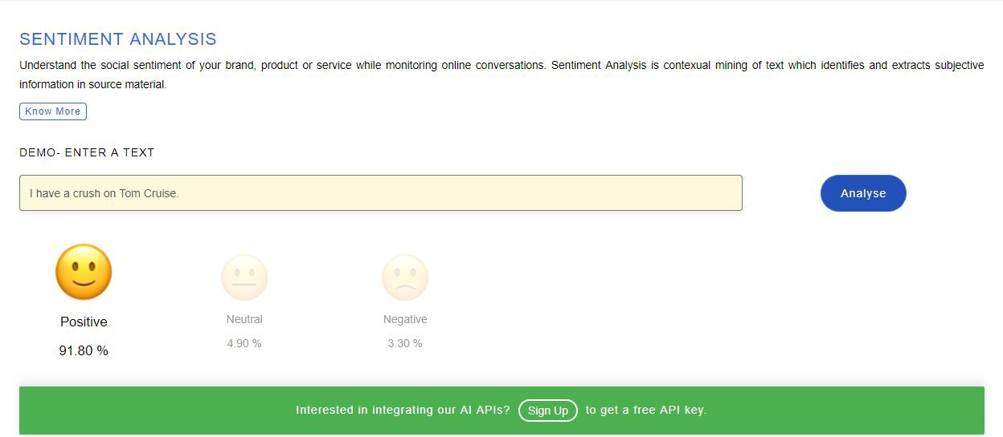
SENTIMENT ANALYSIS

Slide 24

Brands:
use positive and negative classifications to create a sentiment score for conversations.
percentage of mentions that are positive, negative,or neutral,you can get a picture of how your brand is performing over time.

Slide 25
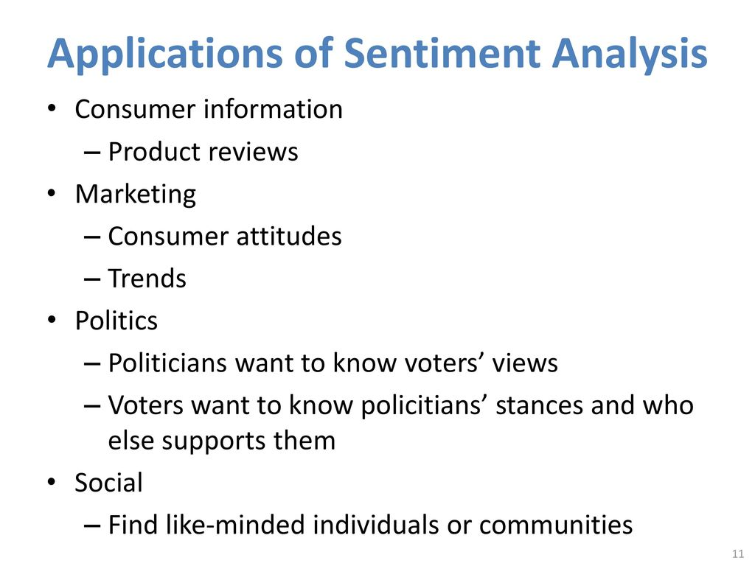


Slide 26

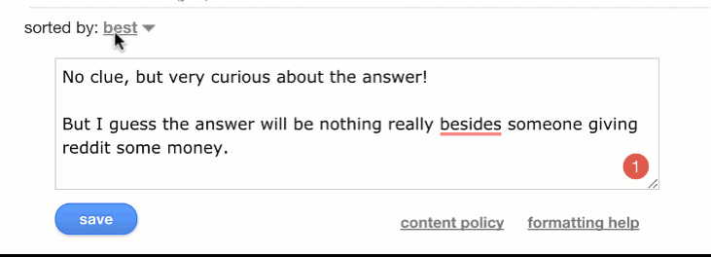
Grammarly’s products is a sophisticated artificial intelligence system built to analyze sentences written in English.
Grammarly’s team of computational linguists and deep learning engineers designs cutting-edge algorithms that learn the rules and hidden patterns of good writing by analyzing millions of sentences from research corpora.

Slide 27
FEATURES:
A complex AI system -lot of computing -it runs in the cloud, rather than locally on your device.
Realm of grammar, spelling, and punctuation correction
Additionally help you fix wordiness, vagueness and hedging, poor word choice, gnarly sentence structure, and even plagiarism.
writing tools are designed to work whatever you do

Slide 28
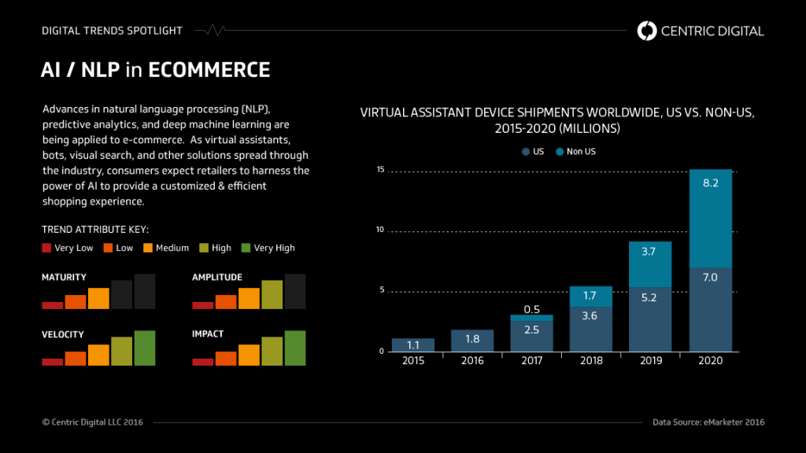

Slide 29
FUTURE OF NLP.
Right now, NLP still struggles to detect a lot of nuances in meaning
ELMo :
language models to obtain embeddings for each word while also considering the context in which the word fits into the sentence or paragraph. Context is such a crucial aspect of NLP that most people
failed to grasp before. ELMo uses bi-directional LSTMs to create the embeddings.
Google Duplex
ITS DEFINITELY THE FUTURE OF EVERY BUSINESS!

Slide 30


